Slide 1

VIDEMUS
We guide the driver.
Plamen Trendafilov | TUM Management & Data Science
Ognyan Trendafilov | AUBG Economics & Finance
ptrendafilov.github.io/Videmus
2026

Slide 2
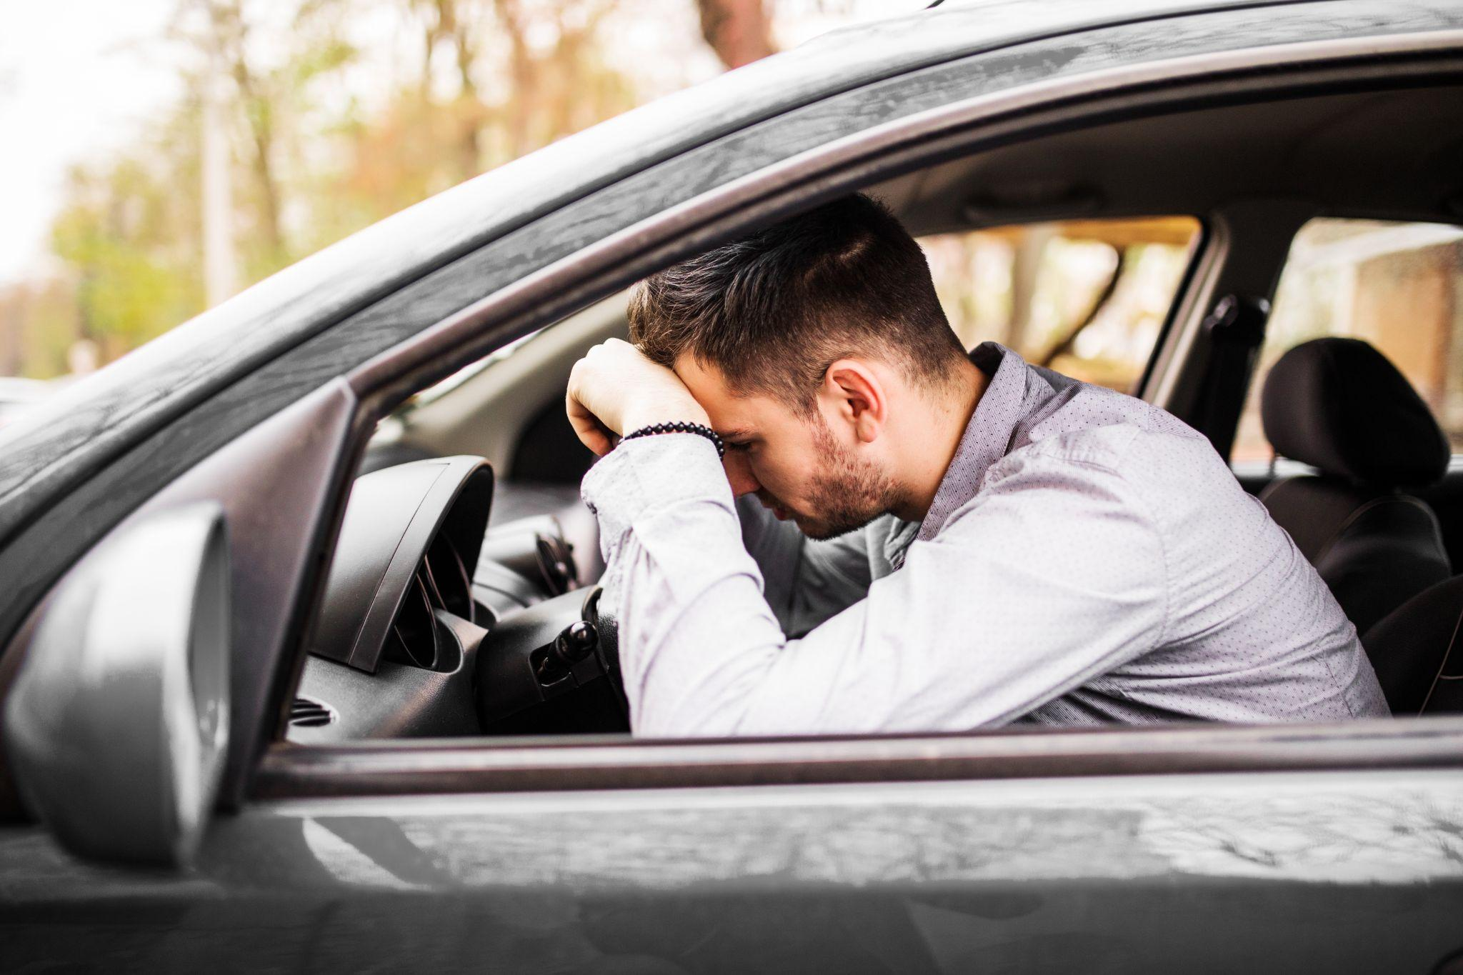
THE PROBLEM
Drivers need guidance.
Every day, drivers face moments of uncertainty. The result is devastating.
1.35M
90%
50M
road deaths / year
caused by human error
injuries annually

Slide 3
THE SOLUTION
Real-time AR driving guidance.
Videmus uses Computer Vision to observe the road in real time and project AR guidance overlays into the driver’s field of view. The driver stays in full control — we make them better, not replace them.
Parking
Pedestrian Safety
Traffic Navigation
AR arrows guide the car into tight spaces with precision.
Real-time detection warns the driver before a dangerous situation.
The system reads traffic lights and guides with AR overlays.

Slide 4
HOW IT WORKS
From camera to guidance.
01
Capture
Camera captures the road environment in real time through AR glasses or phone
02
Detect
YOLO-based Computer Vision model identifies traffic lights, pedestrians, and parking spaces
03
Analyze
System evaluates the situation and determines the optimal driver action
04
Guide
AR overlay projects visual guidance directly into the driver’s field of view

Slide 5
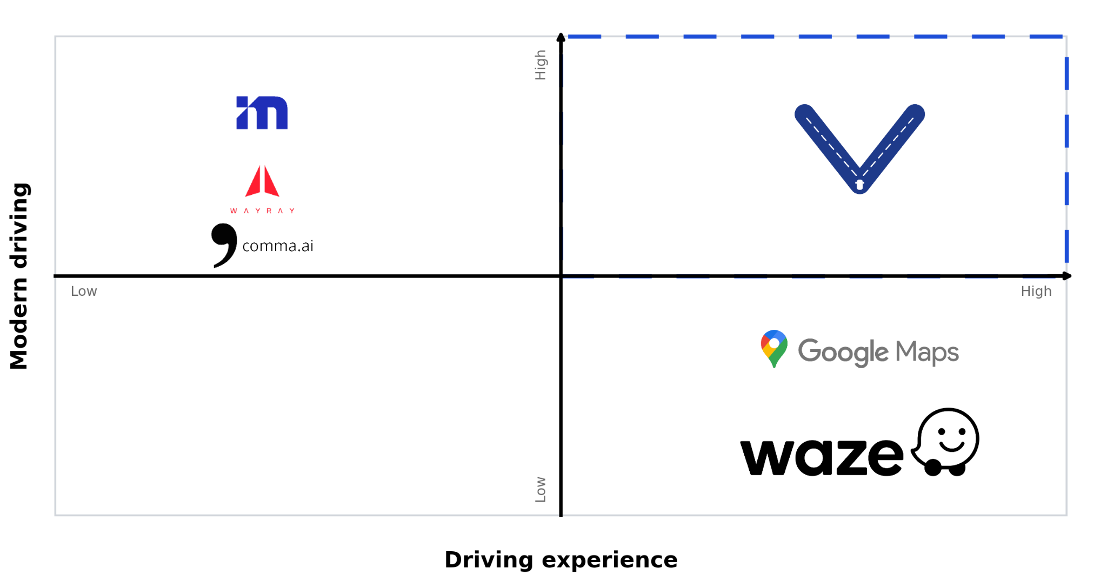
DIFFERENTIATION
We coach. They replace.
Videmus occupies a unique position: enhancing the human driver with modern technology rather than replacing them.

Slide 6
GO-TO-MARKET
Start small. Scale smart.
NOW
NEXT
THEN
FUTURE
Phase 1
Phase 2
Phase 3
Phase 4
Baseline Models
App Integration
Driving Schools
OEM Integration
Develop and train CV models for traffic light, pedestrian, and parking detection.
Integrate models into a mobile application for real-time driving guidance.
Partner with driving schools for testing and validation in controlled environments.
Seek partnerships with car manufacturers for factory-installed systems.

Slide 7
PRODUCT ROADMAP
Built for the future. Starting today.
Apr 2026
Q2 2026
Q3 2026
Q1 2027
Baseline Ready
App MVP
School Pilots
OEM Partnerships
Concept videos, pitch, CV model baseline
Mobile app with real-time detection
Driving school testing and validation
Car manufacturer integration talks

Slide 8

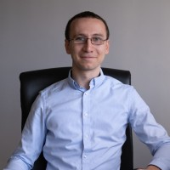
THE TEAM
The right people for the mission.
Plamen Trendafilov
Ognyan Trendafilov
Founder & CEO
Co-Founder & CFO
Management & Data Science Technical University of Munich Product vision, technology, pitch
Economics & Finance American University in Bulgaria Business strategy, partnerships, finance

Slide 9
TRACTION
What we’ve built so far.
Brand & Identity
Concept Videos
Logo, visual identity, and motto established.
Three AR guidance demos produced: parking, pedestrian, and traffic light scenarios.
Baseline Model
Competition Selected
YOLOv8 trained on traffic light detection dataset. Validated on real driving footage - GITHUB
Finalist in Sofia pitch competition with guaranteed prize and HP advisor assigned.
Incubator Pipeline
Website
Application prepared for Constructor Start
Creation of website for the product - https://ptrendafilov.github.io/Videmus

Slide 10
VIDEMUS
We guide the driver.
plamen.l.trendafilov@gmail.com
ptrendafilov.github.io/Videmus
Thank you.

